Slide 1

Remote Work Survey Data Analyzing Employee Productivity
IS 652 Final Presentation
Nandika Talwar

Slide 2
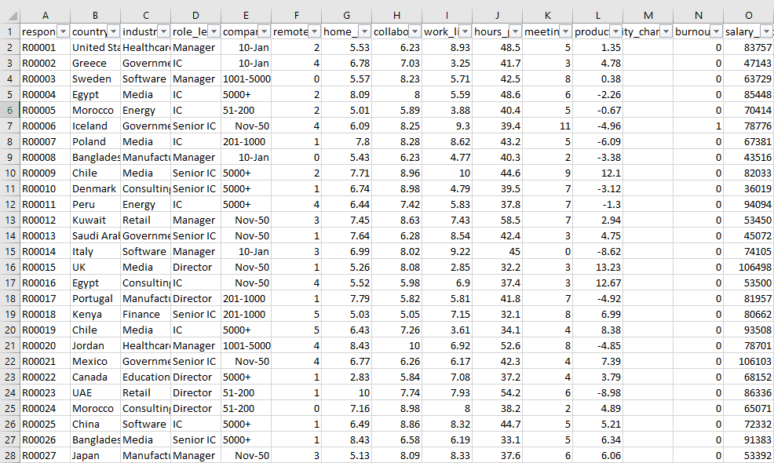
Introduction and Dataset Background
HR Analytics Dataset - analyzes remote work factors that contribute to employee productivity and wellbeing
Beginner-friendly dataset
Data learning dataset
According to a study done by Stanford, employees have been working from home at least once a week during the years of 2019-2023 (Barrero et al., 2023).

Slide 3

Data Cleansing
Focused on U.S. data only
Fixed company size values
Fixed erroneous date values by filtering and changing manually
Removed ID column
Hours Worked/Week: categorized by groups for easier data visualization
Excel formula: IF(H2<35, “<35”, IF(H11<40, “35-39”, …)
Productivity % change
Changed the negative values by adding 4.91 to all values in the column. Making the values positive makes visualization easier

Slide 4
Data Variables
Demographics:
Country
Industry
Role Level
Company Size
Variables:
Work-Life Balance
Home-Office Quality
Remote Days/Week
Hours Worked/Week
Productivity Percent

Slide 5
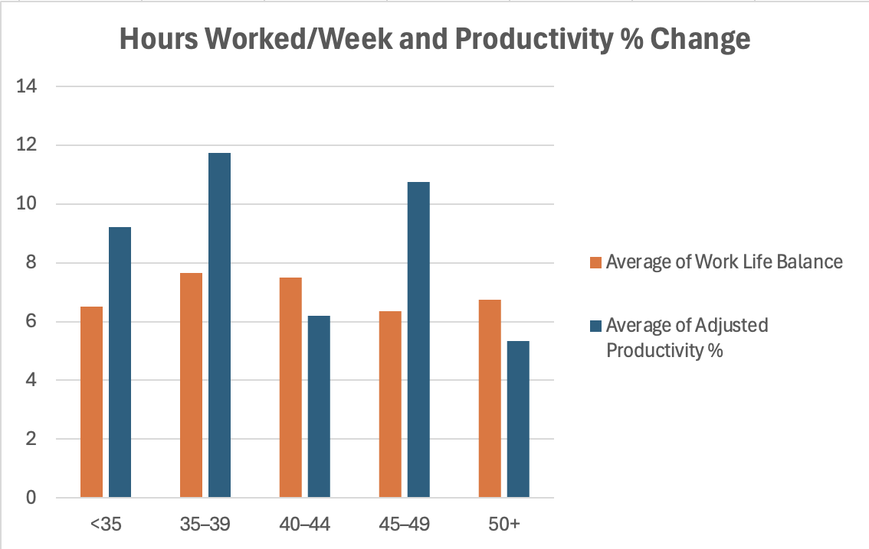
Hours Worked/Week and Work Life Balance vs. Productivity % Change
Clustered column chart
Employees who worked between 35-39 hours and 45-49 hours have the highest increase in productivity score and work life balance
Employees who worked over 50 hours have the lowest improvement in productivity

Slide 6
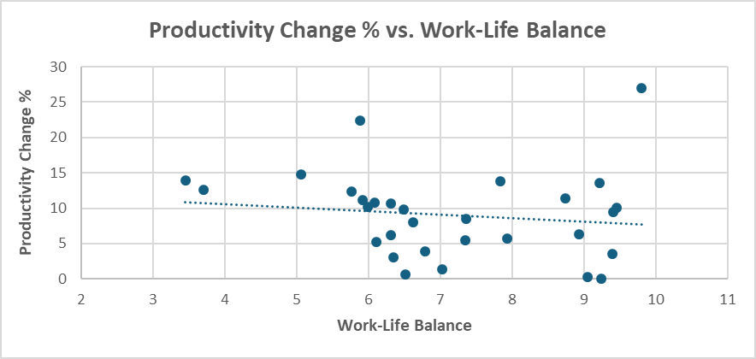
Work-Life Balance vs. Productivity % Change
Scatter chart
Slightly weak negative correlation
Since the variable is a change % score, it doesn’t show the total productivity and can show a weaker relationship between the two variables
Only U.S. filtering

Slide 7

Takeaway and Interpretations
Employees working between 35-39 hours report the highest increase in productivity
Employees working over 50 hours have the lowest improvement in productivity, this could be due to stress and burnout
Work-life balance isn’t as strong of a predictor for productivity change - other factors like workload and amount of meetings etc could be better predictors

Slide 8

Other Ways to Analyze this Data…
Amount of Meetings/Week vs. Remote Days/Week
How does the amount of meetings employees have weekly determine how many remote days they take?
Home office quality vs. Productivity %
How does the quality of our workspace affect productivity?
Remote days/week vs. work-life balance
Does having more remote work days increase work-life balance?

Slide 9
References
https://www.kaggle.com/datasets/philipdave/remote-work-productivity-survey
Barrero, J. M., Bloom, N., & Davis, S. J. (2023, July). The evolution of working from home (Working Paper No. 23-19). Stanford Institute for Economic Policy Research. https://siepr.stanford.edu/publications/working-paper/evolution-working-home

